Slide 1
COIMBATORE INSTITUTE OF TECHNOLOGY
DEPARTMENT OF COMPUTING
MSC DATA SCIENCE
TOPIC : TEXTILE MANAGEMENT
TEAM MEMBERS :
SHYAMSUNDAR SS ~71762332040
SRIJITH R ~71762332044
THEJASHREE B ~71762332052

Slide 2
PROBLEM STATEMENT
This project focuses on creating a textile ordering platform that allows users to select and customize clothing options according to their preferences.
Customers can choose fabric types and dynamically customize styles, such as shirts or pants, tailored to specific needs for men, women, and children.
This platform aims to simplify the customization and ordering process, providing a seamless experience for users seeking personalized apparel
2

Slide 3
OBJECTIVE
Enable Customization: Allow users to select fabric and customize it into different clothing items (e.g., shirts, pants) suited for men, women, and children.
Dynamic User Experience: Create an intuitive interface where users can seamlessly switch between clothing types and customization options specific to each gender.
Simplify Ordering: Streamline the process from fabric selection to customization and checkout, making it easy for users to place orders with tailored specifications.
Personalized Options: Provide a range of customization features, such as size, style, and fabric choice, to meet diverse customer preferences.
Efficient Backend Management: Implement a robust backend to manage orders, track customizations, and ensure efficient order fulfillment.

Slide 4
WHY ARE WE USING?
Automation: Reduces manual errors and improves operational efficiency.
Scalability: A web-based solution can scale easily as business grows.
Accessibility: Real-time access to data from anywhere.

Slide 5





TECHNOLOGIES USED
Flask: Backend web development.
MongoDB: Database management.
HTML5 & CSS3: Web page structure and design.
Bootstrap: Responsive front-end design.
JavaScript: Client-side interactivity.

Slide 6
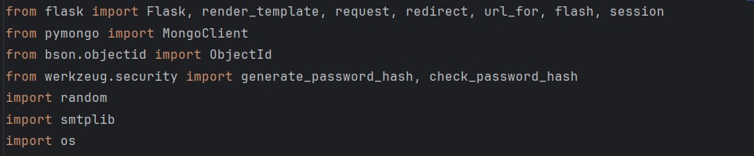
LIBRARIES USED
PyMongo: MongoDB connection and operations.
Werkzeug Security: Secure password hashing.
smtplib: Email handling for sending notifications

Slide 7
USER LOGIN MANAGEMENT
Login Collection:
Stores essential user information such as:
Username: Unique identifier for each user.
Password: Secured using encryption.
Email: For communication and account recovery.
The login collection helps authenticate users, ensuring only registered users can access the application.
User credentials are retrieved from the database and verified when a user attempts to log in.

Slide 8
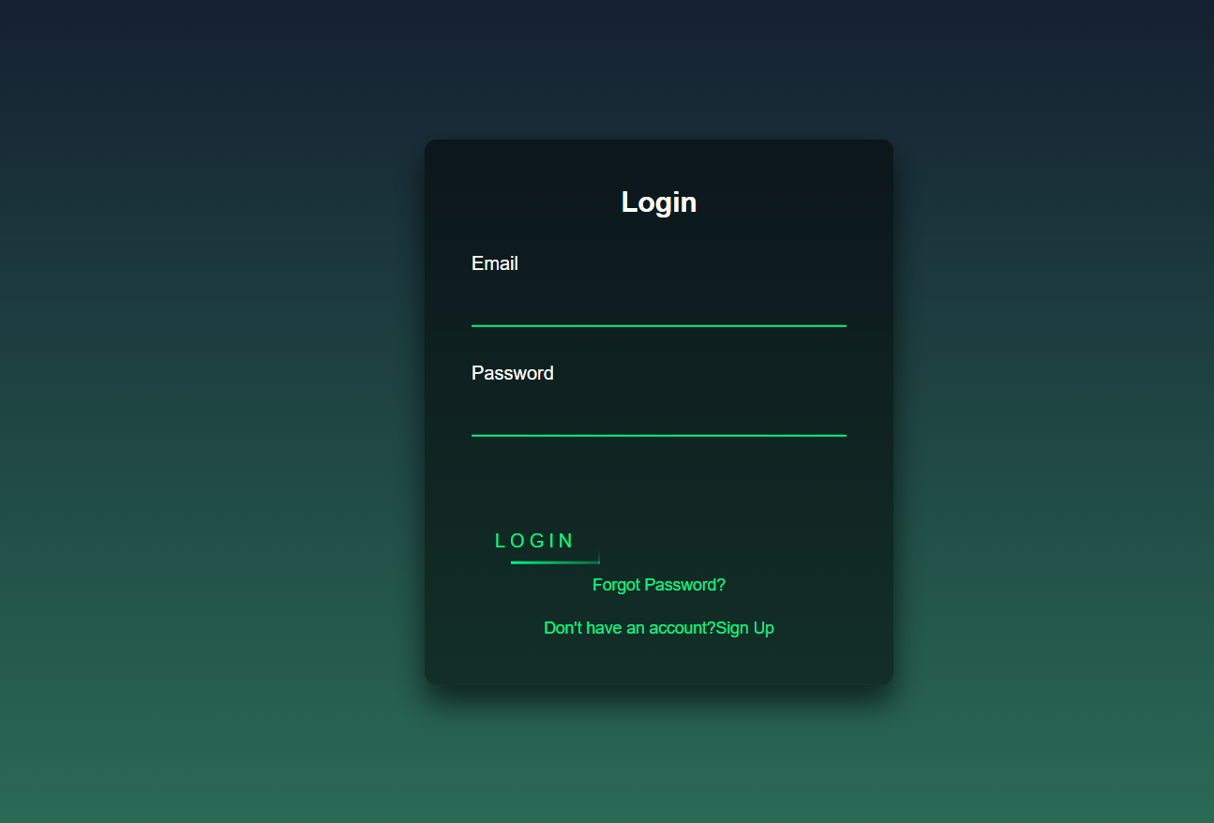
USER LOGIN MANAGEMENT
LOGIN PAGE

Slide 9
USER LOGIN MANAGEMENT
Signup Collection:
Stores essential user information such as:
Name: The full name of the user for identification purposes.
Email: Used for communication and account verification.
Contact Number: Allows for direct communication with the user.
Gender: Captures the user’s gender to personalize the experience.
Age: Used to offer age-appropriate recommendations or features.
Address: Stores the user’s address for delivery or location-based services.
The signup collection helps register new users, gathering essential details for account creation and personalized service. User information is securely stored in the database and used to facilitate communication and customization within the application.

Slide 10
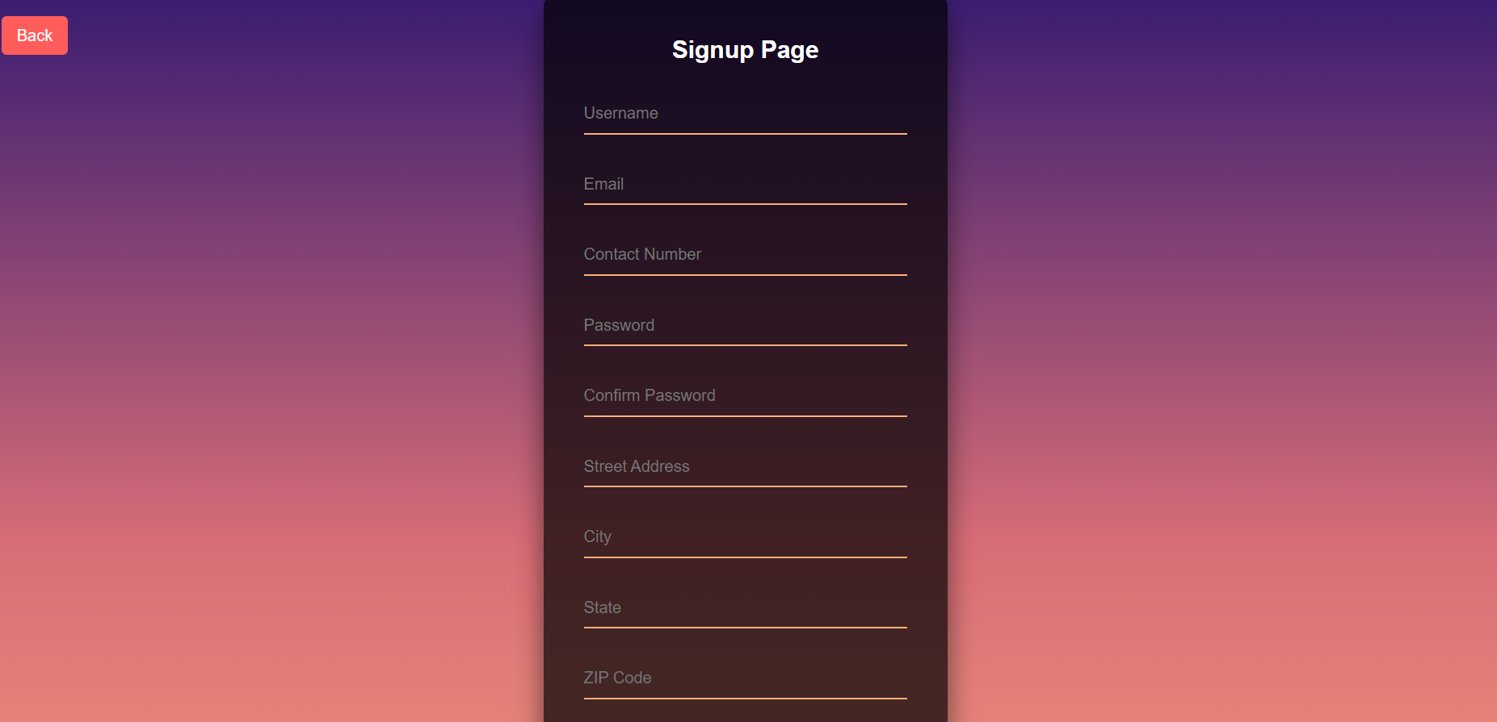
USER LOGIN MANAGEMENT
SIGNUP PAGE

Slide 11
DRESS COLLECTION
Dress Collection: Stores comprehensive information about each dress displayed on the front page, allowing users to view and explore a wide range of dresses with ease.
Color: The available color options for each dress.
Price: The cost of each dress, displayed to the user.
Description: Detailed information about the dress to inform the user.
Cloth Type: Specifies the type of fabric used (e.g., cotton, silk), helping users understand material quality.
The dress collection supports a filter and search functionality, which leverages NLP algorithms to provide relevant search results and filtering options. Users can refine their search by color, price, or cloth type, creating a more personalized shopping experience.

Slide 12
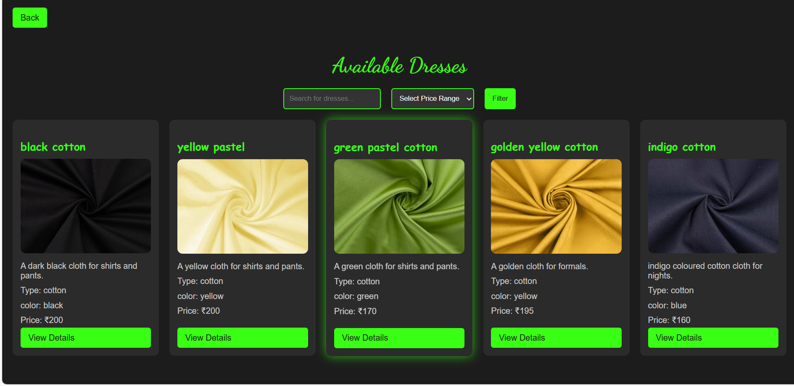
DRESS COLLECTION
HOME PAGE

Slide 13
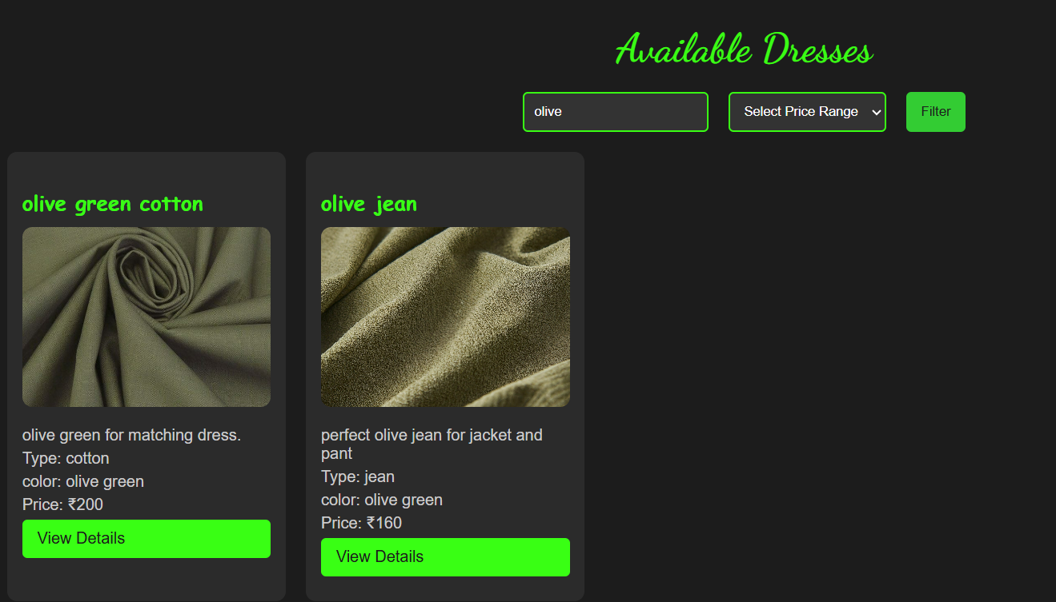
DRESS COLLECTION
SEACH OPTION

Slide 14
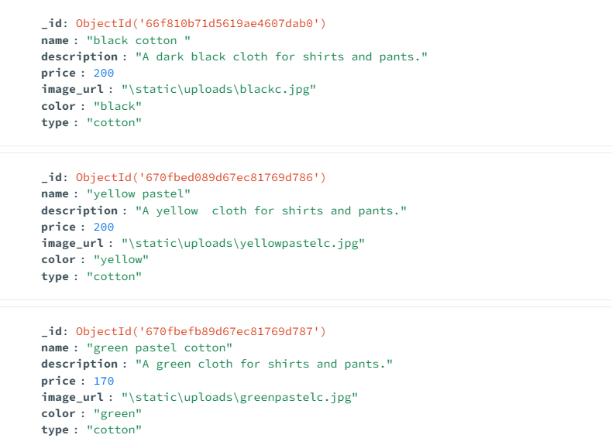
DRESS COLLECTION
DRESSES ARE STORED IN DATABASE

Slide 15
DRESS DETAIL PAGE
Overview: The Dress Detail Page provides an in-depth view of the selected dress, showcasing details like color, fabric type , ratings, pricing, and user reviews.
FEATURES:
Dress Information:
Displays the dress name and fabric type (e.g., Black Cotton).
Shows an image of the dress fabric for visual reference.
Provides a brief description to give users more context about the material and its suitability.
Price per meter: Shows the cost, allowing users to make informed purchasing decisions.
Average Rating: Displays user feedback with an average rating out of 5.

Slide 16
DRESS DETAIL PAGE
2.Order Button:
A clear, prominent button to initiate the order process.
3.Top Reviews Section:
Users can write a review and rate the dress.
The submit review button allows users to add their review to the database.
Shows existing user reviews, with the reviewer's name and comments, offering social proof for other users.
4.Related Dresses:
Suggests similar or complementary dresses, enhancing user experience by helping users explore more options.

Slide 17
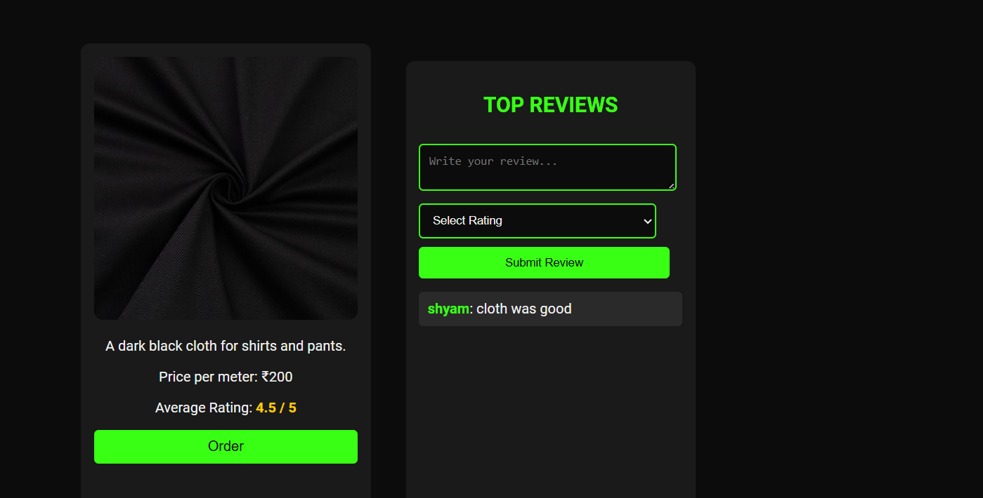
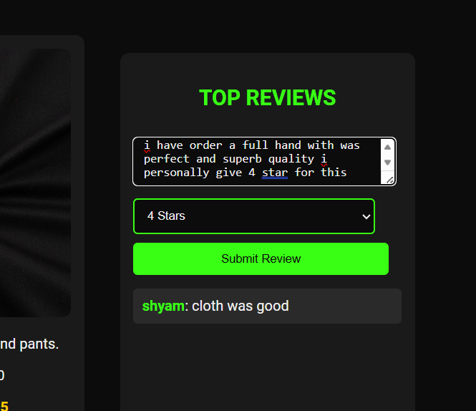
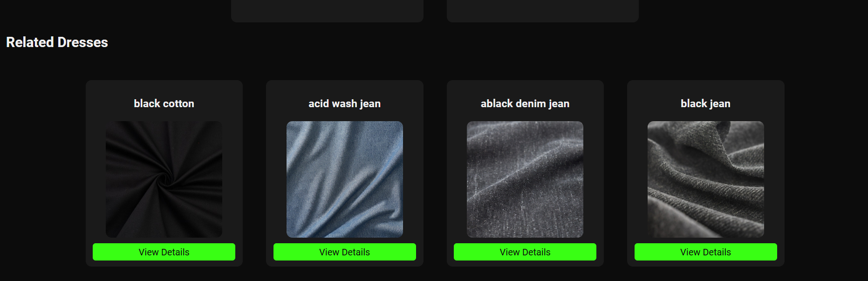
DRESS DETAIL

Slide 18
CUSTOMIZE ORDER PAGE
Overview:
The Customize Order Page allows users to personalize their clothing orders with dynamic customization options based on gender, dress type, and other specifications.
Key Features:
Gender Selection:
Users can choose their gender by selecting gender icons (Men, Women, Children).
The form dynamically updates based on the selected gender, providing appropriate dress types and sizes.
Dress Type:
Options for different dress types (e.g., pants, shirts) are displayed based on the selected gender.
Dress types update dynamically to show relevant options tailored to the chosen gender.

Slide 19
CUSTOMIZE ORDER PAGE
3.Dress Designs:
1.Once a dress type is selected, design variations specific to that type appear (e.g., styles for pants or shirts), giving users more customization choices.
4.Age and Size Options:
1.For children, the age field helps in offering age-appropriate size options.
2.Size selection fields are available, displaying only the sizes relevant to the selected dress type (e.g., specific measurements for pants or shirts).
5.Dynamic Pricing:
1.The price updates in real-time based on user selections, allowing users to see cost adjustments as they customize.
2.Price changes take into account fabric type, dress type, and size to provide an accurate cost.
6.Order Now Button:
1.A prominent button to place the order after completing customization.
2.Streamlines the process, allowing users to complete their order with a single click.

Slide 20
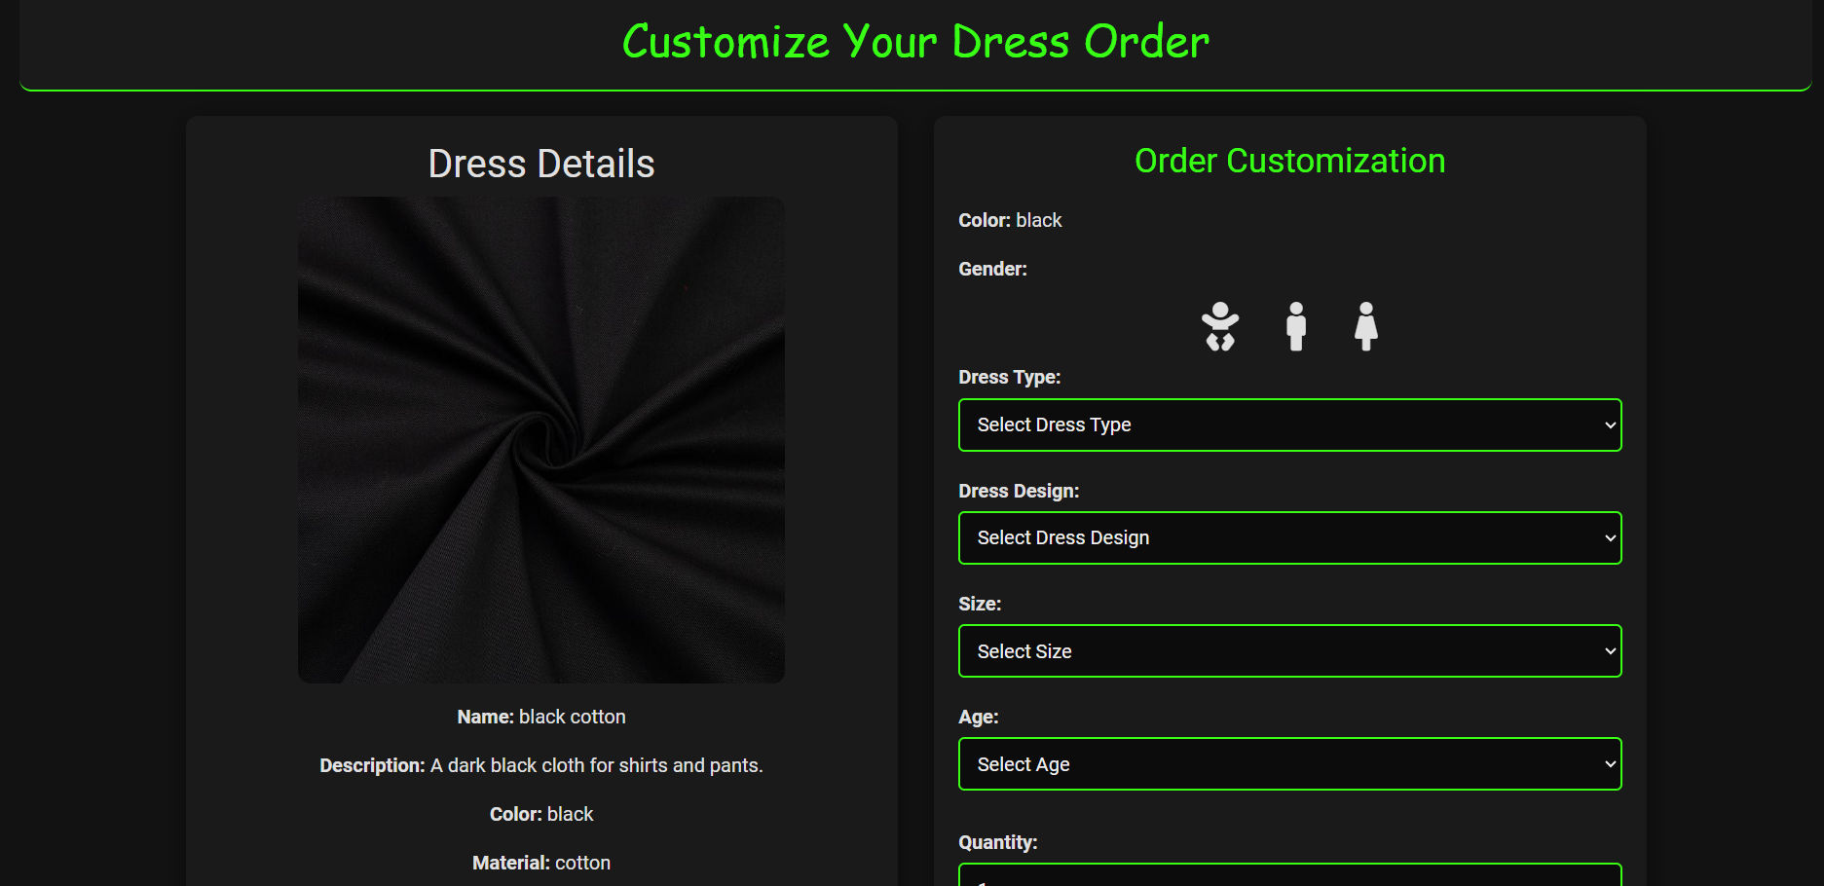
CUSTOMIZE ORDER PAGE

Slide 21
REVIEW COLLECTION
Overview: The Dress Review and Edit Page provides users or advanced users the ability to review and update dress details dynamically. This feature is essential for maintaining accurate, up-to-date information on each dress.
Key Features:
Dress Information Overview:
Displays current dress details such as name, color, price, description, and cloth type.
Allows users to view existing data before making changes, ensuring consistency.
Edit Fields:
Each dress detail field (e.g., dress type,dress design,size) is editable.
Dropdowns and input fields dynamically adjust based on the selected attributes, simplifying the editing process for specific aspects like color and fabric type.

Slide 22
REVIEW COLLECTION
3.Dynamic Updates:
As fields are updated, the preview and price update in real-time, showing users the impact of their changes.
Ensures a user-friendly experience by allowing immediate feedback for edits.
4.Save Changes Button:
A clear, prominent Save Changes button is provided to confirm updates.
When clicked, the updated information is saved to the database, ensuring the front-end dress listings are always up-to-date.

Slide 23
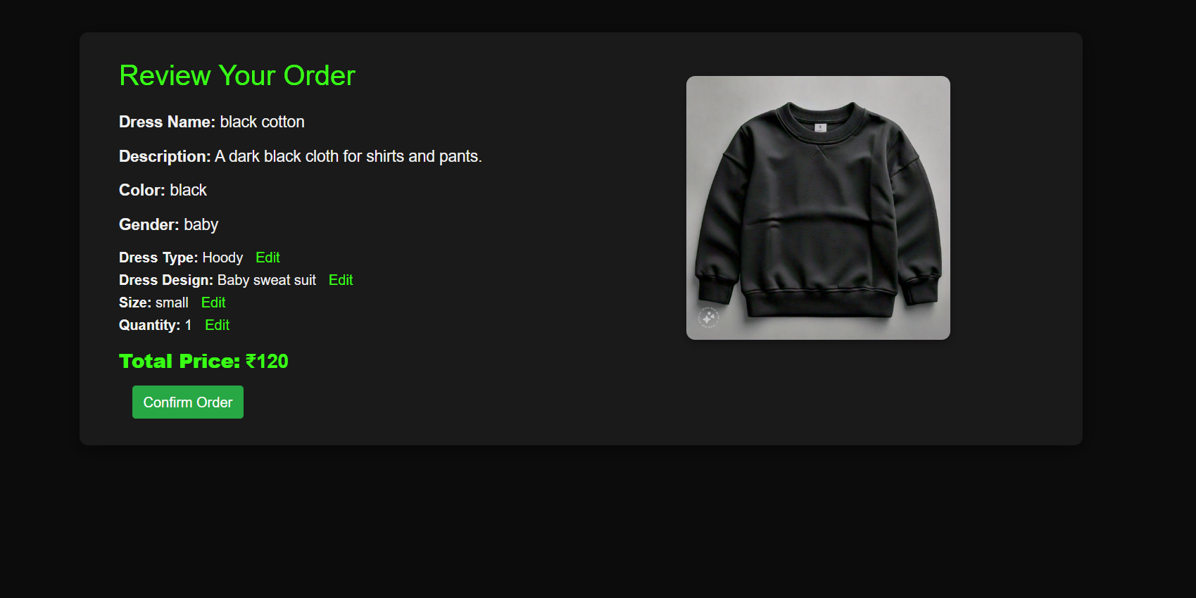
REVIEW COLLECTION

Slide 24
ORDER SUCCESS
OVERVIEW:
This page serves as a confirmation for users after they successfully place an order, reinforcing their trust in the purchasing process.
It displays comprehensive details of the ordered dress, including style, size, color, and any customization options selected during the ordering process.
User details, such as their name, contact information, and delivery address, are prominently shown to ensure that the order is correctly linked to the user.
All orders are systematically stored in a new collection within the database, allowing for efficient management and easy retrieval of order history.
This organized structure enhances operational efficiency and supports customer service efforts by providing quick access to past orders for inquiries or returns.
Additionally, users can refer back to this page at any time to verify their order details, fostering a positive user experience and encouraging repeat business.

Slide 25
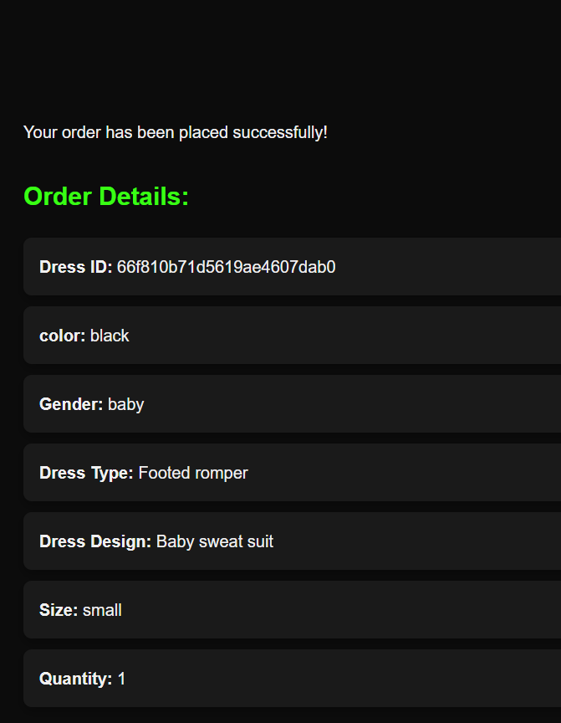
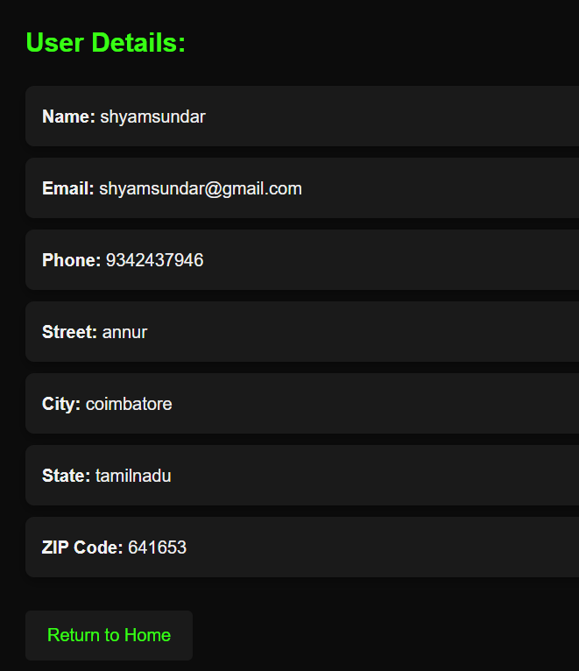
ORDER SUCCESS

Slide 26
LIBRARIES AND FUNCTIONALITIES
Werkzeug Security:
Provides secure password hashing and verification for user authentication.
Prevents any direct storage of raw passwords, reducing the risk of password leaks.
This ensures that users’ passwords are encrypted and secure, adding an extra layer of protection.
Random Module:
Used to generate random OTPs (One-Time Passwords), typically 6-digit numbers.
OTP Use Cases:
During user registration, an OTP is sent to verify the user's email address.
OTPs are also used for sensitive actions like resetting passwords or confirming orders.

Slide 27
ADVANTAGES AND DISADVANTAGES
Advantages:
Scalable Data Management:
MongoDB's flexible NoSQL database allows for seamless scalability, making it easier to store and manage vast amounts of data, including user information, dresses, orders, and reviews.
Enhanced Security:
Utilizing Werkzeug Security for password hashing ensures encrypted storage of sensitive user data, improving the security of login details and reducing risks of data breaches.
Disadvantages:
1.Lack of Complex Query Support:
MongoDB may not be ideal for complex relational queries, which could pose a challenge when the project scales and requires more advanced database operations.
2.Email Dependency:
Using smtplib for email notifications requires a reliable mail server. If the mail server faces downtime or issues, users may not receive important notifications like OTPs and order confirmations.

Slide 28
DB OVERVIEW
This project is an online textile management system built using Flask and MongoDB. The platform handles user authentication, product management, order tracking, and reviews for dresses.
Login Module: Stores user login details securely using hashed passwords with Werkzeug Security.
Dress Module: Stores details of different clothes in the collection, offering seamless browsing and purchasing for users.
Order Management: The Confirmed Order collection tracks all orders placed by users, keeping records of what has been purchased.
Review System: Stores reviews for individual clothes, allowing users to give feedback on the products.

Slide 29
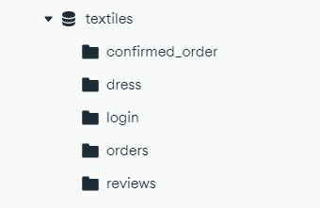
DB OVERVIEW
DATABASE STRUCTURE

Slide 30
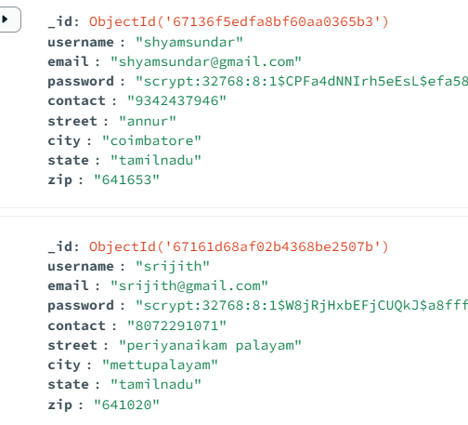
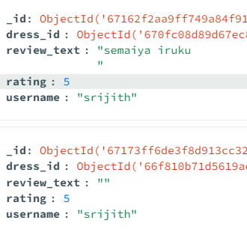
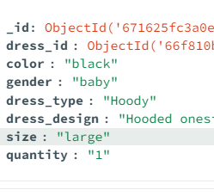
DB OVERVIEW
MONGODB COLLECTIONS

Slide 31
CONCLUSION
In conclusion, the Textile Management project has successfully demonstrated the integration of technology into the textile industry, addressing key challenges such as inventory management, supply chain optimization, and customer engagement. Through the implementation of an efficient database system, we have streamlined operations, improved data accessibility, and enhanced decision-making capabilities.
The project's results indicate a significant reduction in operational costs and improved responsiveness to market demands. By leveraging data analytics and user-friendly interfaces, stakeholders can make informed decisions, fostering a more agile and competitive textile business environment.

Slide 32
THANK YOU!

